Slide 1

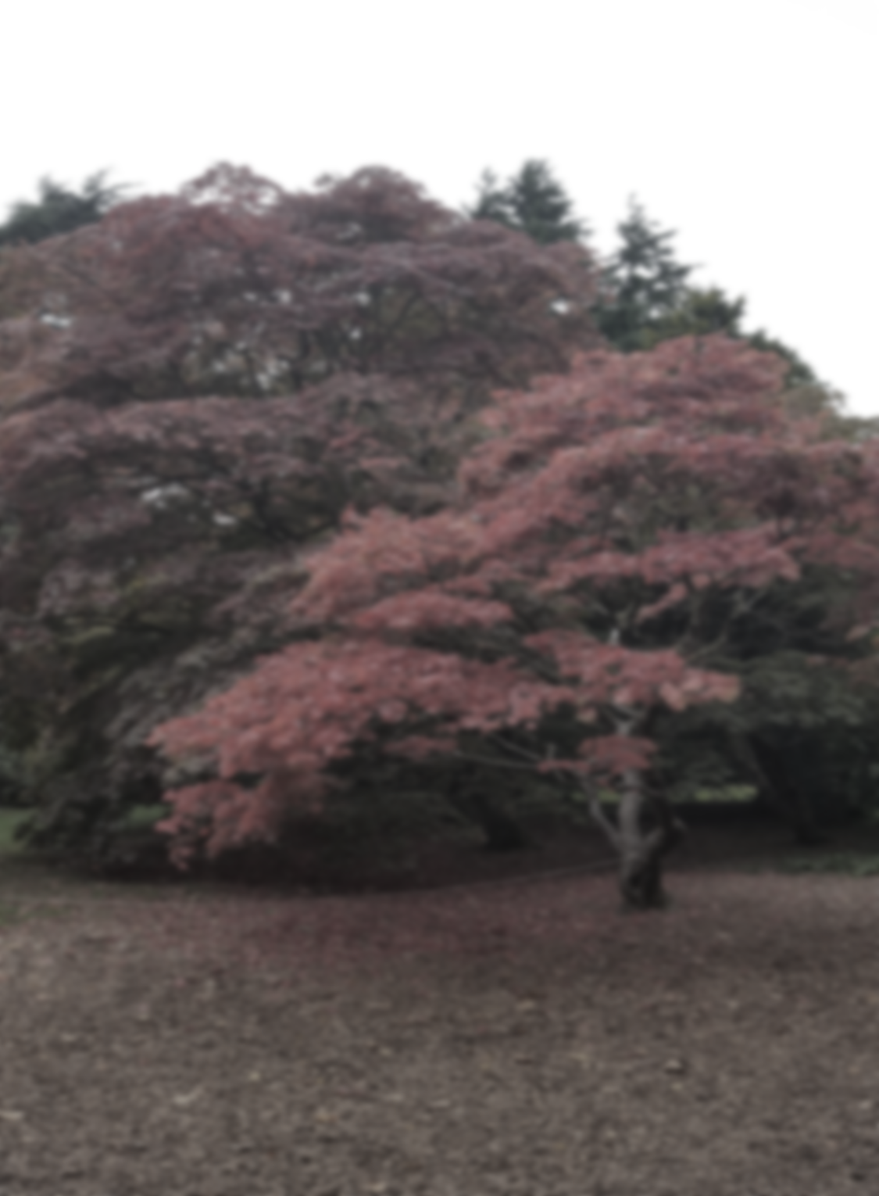
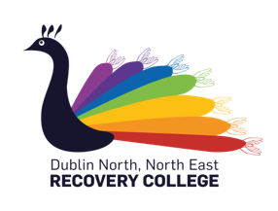

THE DUBLIN NORTH, NORTH EAST RECOVERY COLLEGE
Dublin North, North East Recovery College
In
Nth Dublin Area – Autumn Courses 2019
Mama Wellness
Supporting Maternal Wellbeing
This workshop is open to women who are expecting, mothers who have children, mother’s who have lost babies, family members and professionals who support mothers.
.
On completion of this course learners will explore:
· singing, performance and writing melodies
· song writing structure.
· rhythm and percussion
· lyric writing
· Collaboration using creative group work techniques.
Participants will explore:
Self care – why it is important for mothers
Making time for mother
Mindfulness and Visualisation exercises
Song creation collective!
This musical adventure explores the different components involved in song writing and the transformative effect that music can have on a persons mental health, supporting participants towards working collaboratively in the development and performance of a piece of music.
Course start date: Tuesday 22nd of November
Format: 19.30- 21.30pm for 4 weekly evening sessions
Venue: Interfaith Centre, DCU
Dates: Tuesday November 19th
Venue: Recovery College Room, DCU
Format: Introductory Three Hour Workshop
Cost: This is a free course.
To register, contact the Recovery College:
Phone- 01 7007907
Email- recoverycollege@dcu.ie
Website- www.recoverycollege.ie

