Slide 1

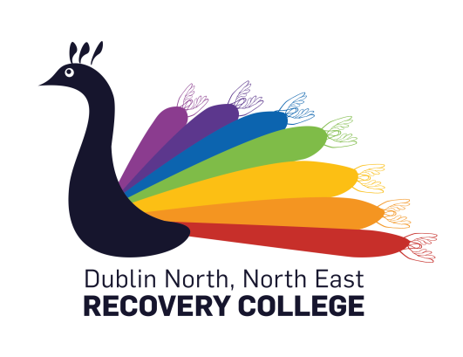

ARI CHO 8 Steering Group in collaboration with the Dublin North, North East Recovery College
.
So, what the hell is Coproduction?
This cooperative learning programme explores the value of genuine transformative coproduction approaches in mental health settings, supporting participants towards working collaboratively in the development and delivery of recovery orientated education, supports and services.
Facilitators: Catherine Sweeney, Martha Griffin & Teresa Carpenter
On completion of this course learners will explore:
· The history and value of coproduction approaches.
· Collaboration using creative group work techniques.
· Power sharing and meaningful participation,
· Importance of trust, collective risk-taking and team work.
· The value of strengths based approaches to mental health
Course start date:1st October 2019
Format: Three Half day sessions (9.30am – 12.30 pm)
Venue: Red Door Project Drogheda
    This course is open to people who use work in and support people in the Louth / Meath Mental Health Services. For more information about these courses go to: www.recoverycollege.ie/our-courses
To register, contact the Recovery College:
    phone- 01 7007907
    email- recoverycollege@dcu.ie
    website- www.recoverycollege.ie

