Slide 1

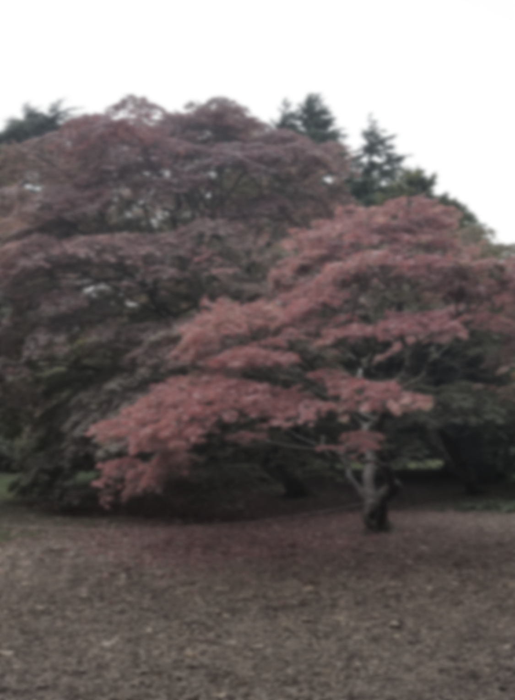



THE DUBLIN NORTH, NORTH EAST RECOVERY COLLEGE
Louth Area – Autumn Courses
Dublin North, North East Recovery College
In collaboration with the DCU School of Nursing & Human Sciences
Song creation collective!
This musical adventure explores the different components involved in song writing and the transformative effect that music can have on a persons mental health, supporting participants towards working collaboratively in the development and performance of a piece of music.
Mama Wellness – Supporting
Maternal Wellbeing
This course is open to everyone: including women who are expecting, mothers who have children, mother’s who have lost babies, family members and professionals who support mothers.
On This Course Participants will explore:
Self care and self love and why it is important for mothers
Dealing with challenges
Power and intuition
Compassion and gratitude
Restorative Yoga and introduction to being mindful
On completion of this course learners will explore:
· singing, performance and writing melodies
· song writing structure.
· rhythm and percussion
· lyric writing
· Collaboration using creative group work techniques.
Week 1 - Self Care
Week 2 - Self Love
Week 3 - Dealing with challenges
Week 4 - Visualising
Week 5 - Power and intuition
Week 6 - Compassion and gratitude
Start Date: Friday November 8th (10am-12pm)
Format: Four Weekly Two Hour Sessions
Venue: DKIT Dept. of Nursing, Midwifery and Early Years
Cost: 10 euro for the course
Course start date: Tuesday 22nd of November
Format: 19.30- 21.30pm for 4 weekly evening sessions
Venue: Interfaith Centre, DCU
To register, contact the Recovery College:
Phone- 01 7007907
Email- recoverycollege@dcu.ie
Website- www.recoverycollege.ie

