Slide 1
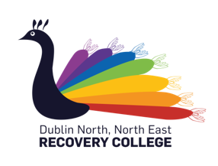


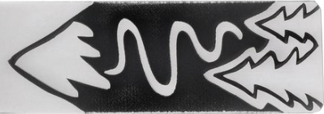
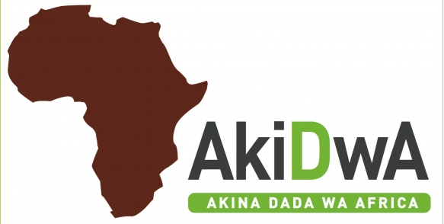




:
ration with the DCU School of Nursing & Human Sciences
‘Journeys – What I Know Now?’
Festival Invitation
As part of the First Fortnight Mental Health Arts Festival 2020 we hereby invite you to join us on Friday January 10th for a morning of transcultural events, understanding and integration of wellbeing.
Journeys Include:
‘What I Know Now’ Book Launch
‘Song Creation Collective’ CD Launch
Exhibitions & workshops include:
The River of Life - AkiDwA
Grub Box - Pavee Point
Design, Fashion, Arts and Crafts - Cairde
Poetry Workshop - Sliver Thread
.
On completion of this course learners will explore:
· singing, performance and writing melodies
· song writing structure.
· rhythm and percussion
· lyric writing
· Collaboration using creative group work techniques.
Song creation collective!
This musical adventure explores the different components involved in song writing and the transformative effect that music can have on a persons mental health, supporting participants towards working collaboratively in the development and performance of a piece of music.
Course start date: Tuesday 22nd of November
Format: 19.30- 21.30pm for 4 weekly evening sessions
Venue: Interfaith Centre, DCU
Venue: DCU School Of Nursing, Psychotherapy and Community Health
Date / Time: Friday January 10th / 9.15 – 1pm
To Register, Contact DNNE Recovery College:
Phone- 01 7007907
Email- recoverycollege@dcu.ie
Website- www.recoverycollege.ie
Silver Thread.ie

