Slide 1

Dublin North, North East Recovery College(DNNERC): A Community Response to Co-optation of Recovery Education
Martha Griffin & Líam Mac Gabhann
www.recoverycollege.ie

Slide 2
Once upon a time Recovery Colleges were lauded as a place where family’s, service users and service provider professionals could engage in liberating transformative co-created educational pursuits that enhanced recovery literacy and life experiences for college participants.

Slide 3



Slide 4
What has happened to Recovery Education?
To Recovery Colleges governance and support
To Peer Education
To course provision
To the place of Recovery in Recovery Education

Slide 5
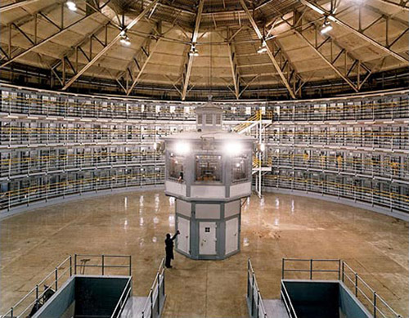

Slide 6
The consequences?
Standardisation of educational content
Marginalisation of potential peer educators
Service centric content and delivery
Prescriptive education
Diluted co-production
Recovery education incorporated into service provision and psychiatric norms
Recovery education positioned within the mental health bubble outside of ‘community’
Resistance to Recovery education in the ‘community’

Slide 7


Slide 8
So what did, can Recovery Colleges Offer?
Personal & Social Recovery
Emancipatory Adult Education
Community Development
Co- Production

Slide 9
Recovery education has a valuable place within services and within communities. It is our contention from evidence so far that when created in a collaborative alternative community, not beholden to biocentric organisational cultural norms and restrictive service focussed governance structures; that it has a greater effect on peoples recovery experiences.

Slide 10

Dublin North, North East Recovery College
We aim to
Provide a platform for mental health recovery, through empowering and transformative education, assisting people to determine their own meaningful avenues towards wellbeing.
Provide a shared learning environment, where both lived experience (people overcoming mental distress, their family and friends) and professional experience is respected equally.
Move people collectively beyond clinical patient, professional and carer roles, towards being students of recovery.
Work in partnership with recovery orientated individuals, services, groups and agencies to create an inclusive culture of recovery and connectedness in the community.
Embed the Recovery College in Dublin North, North East as a sustainable community partnership

Slide 11
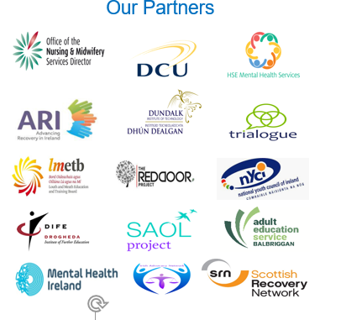

Slide 12
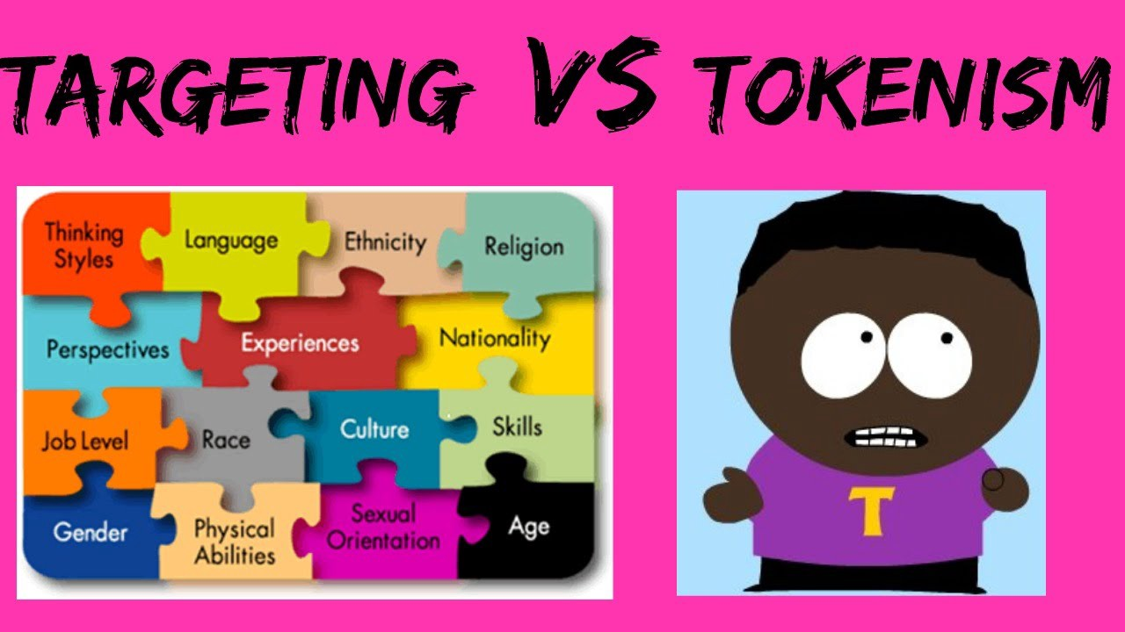

Coproduction or is it co-option?
“The ‘service user’ being invited to sit in the back seat once the agency has decided where the car is going.
Coproduction roots in social justice and community development .
“It appears to me that the term ‘co-production’ has lost its way, becoming stale and jaded, but worst of all it seems that “co-production” is thrown around in abandon for the good and the great, making them feel good by ticking a box” (Ford, Expert Link, 2017).

Slide 13
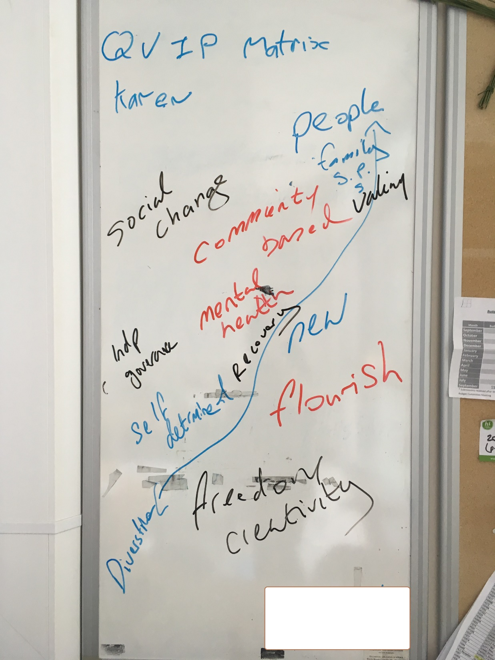
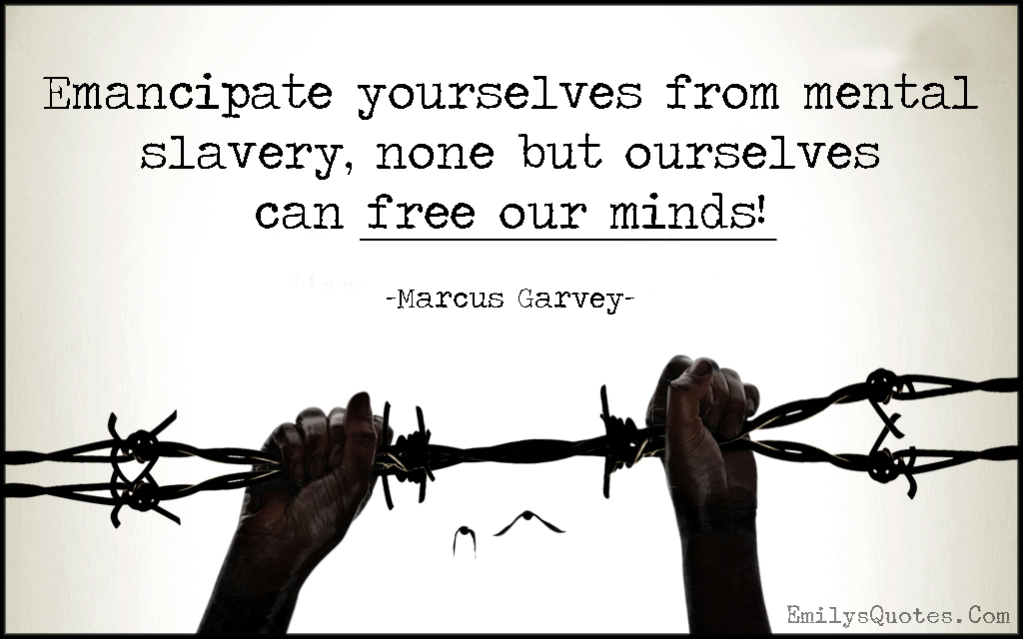
Emancipatory Space & Ethos
Self determination
Human improvement
Community literacy of mental health
Dismantling oppressive assumptions about ourselves & the world
Reconstruction new belief systems
Facilitative space – no pre determined ideas of where we will end up - Problem-posing dialogue (Freire)

Slide 14
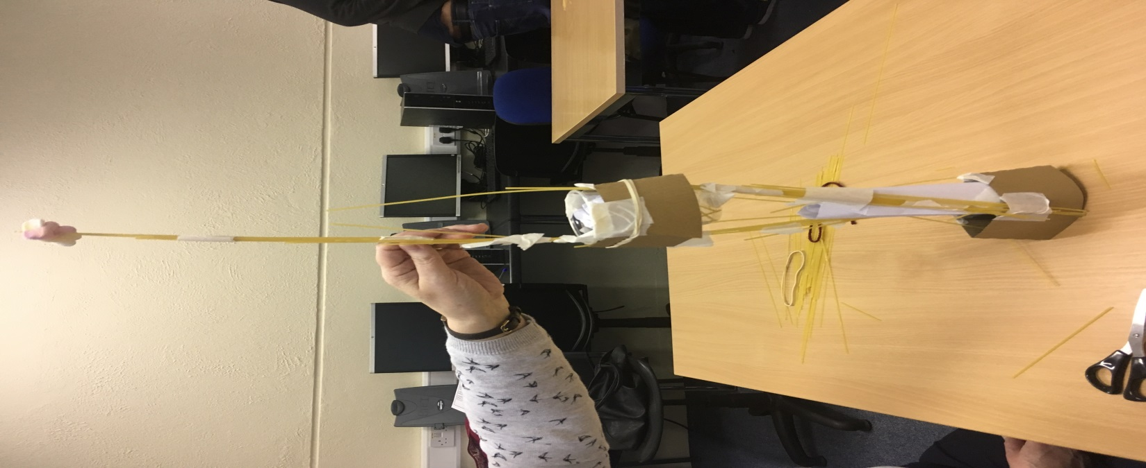
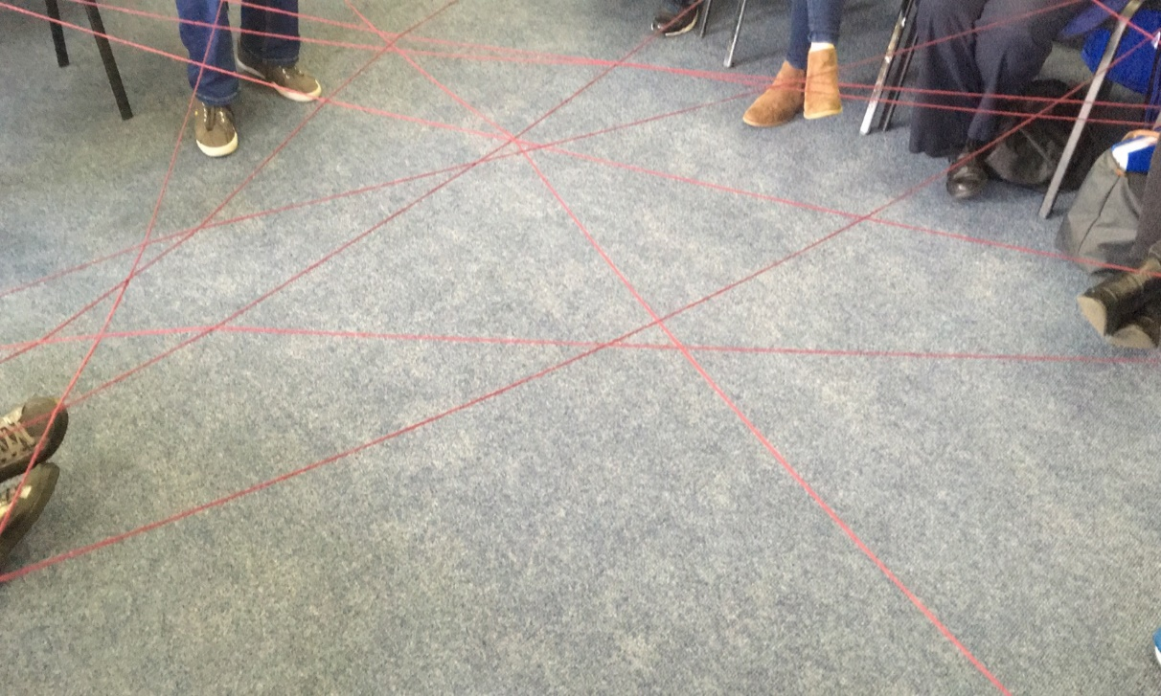

Learning Together – what are local needs? Let’s identify and design courses together
Enriching Life, Relationships, Health and Wellbeing and Life Skills

Slide 15
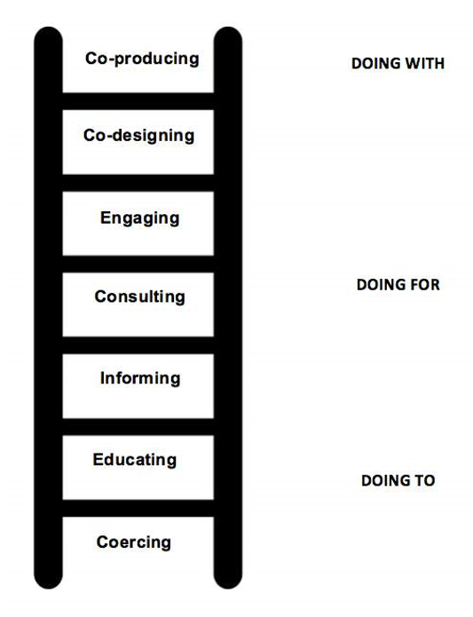
Raising consciousness - Grappling with the bigger issues together
Is it me or is it the meds?
What the hell is coproduction?
Mama Wellness
Stigma and Discrimination
Understanding and Renegotiating Trauma

Slide 16



Slide 17
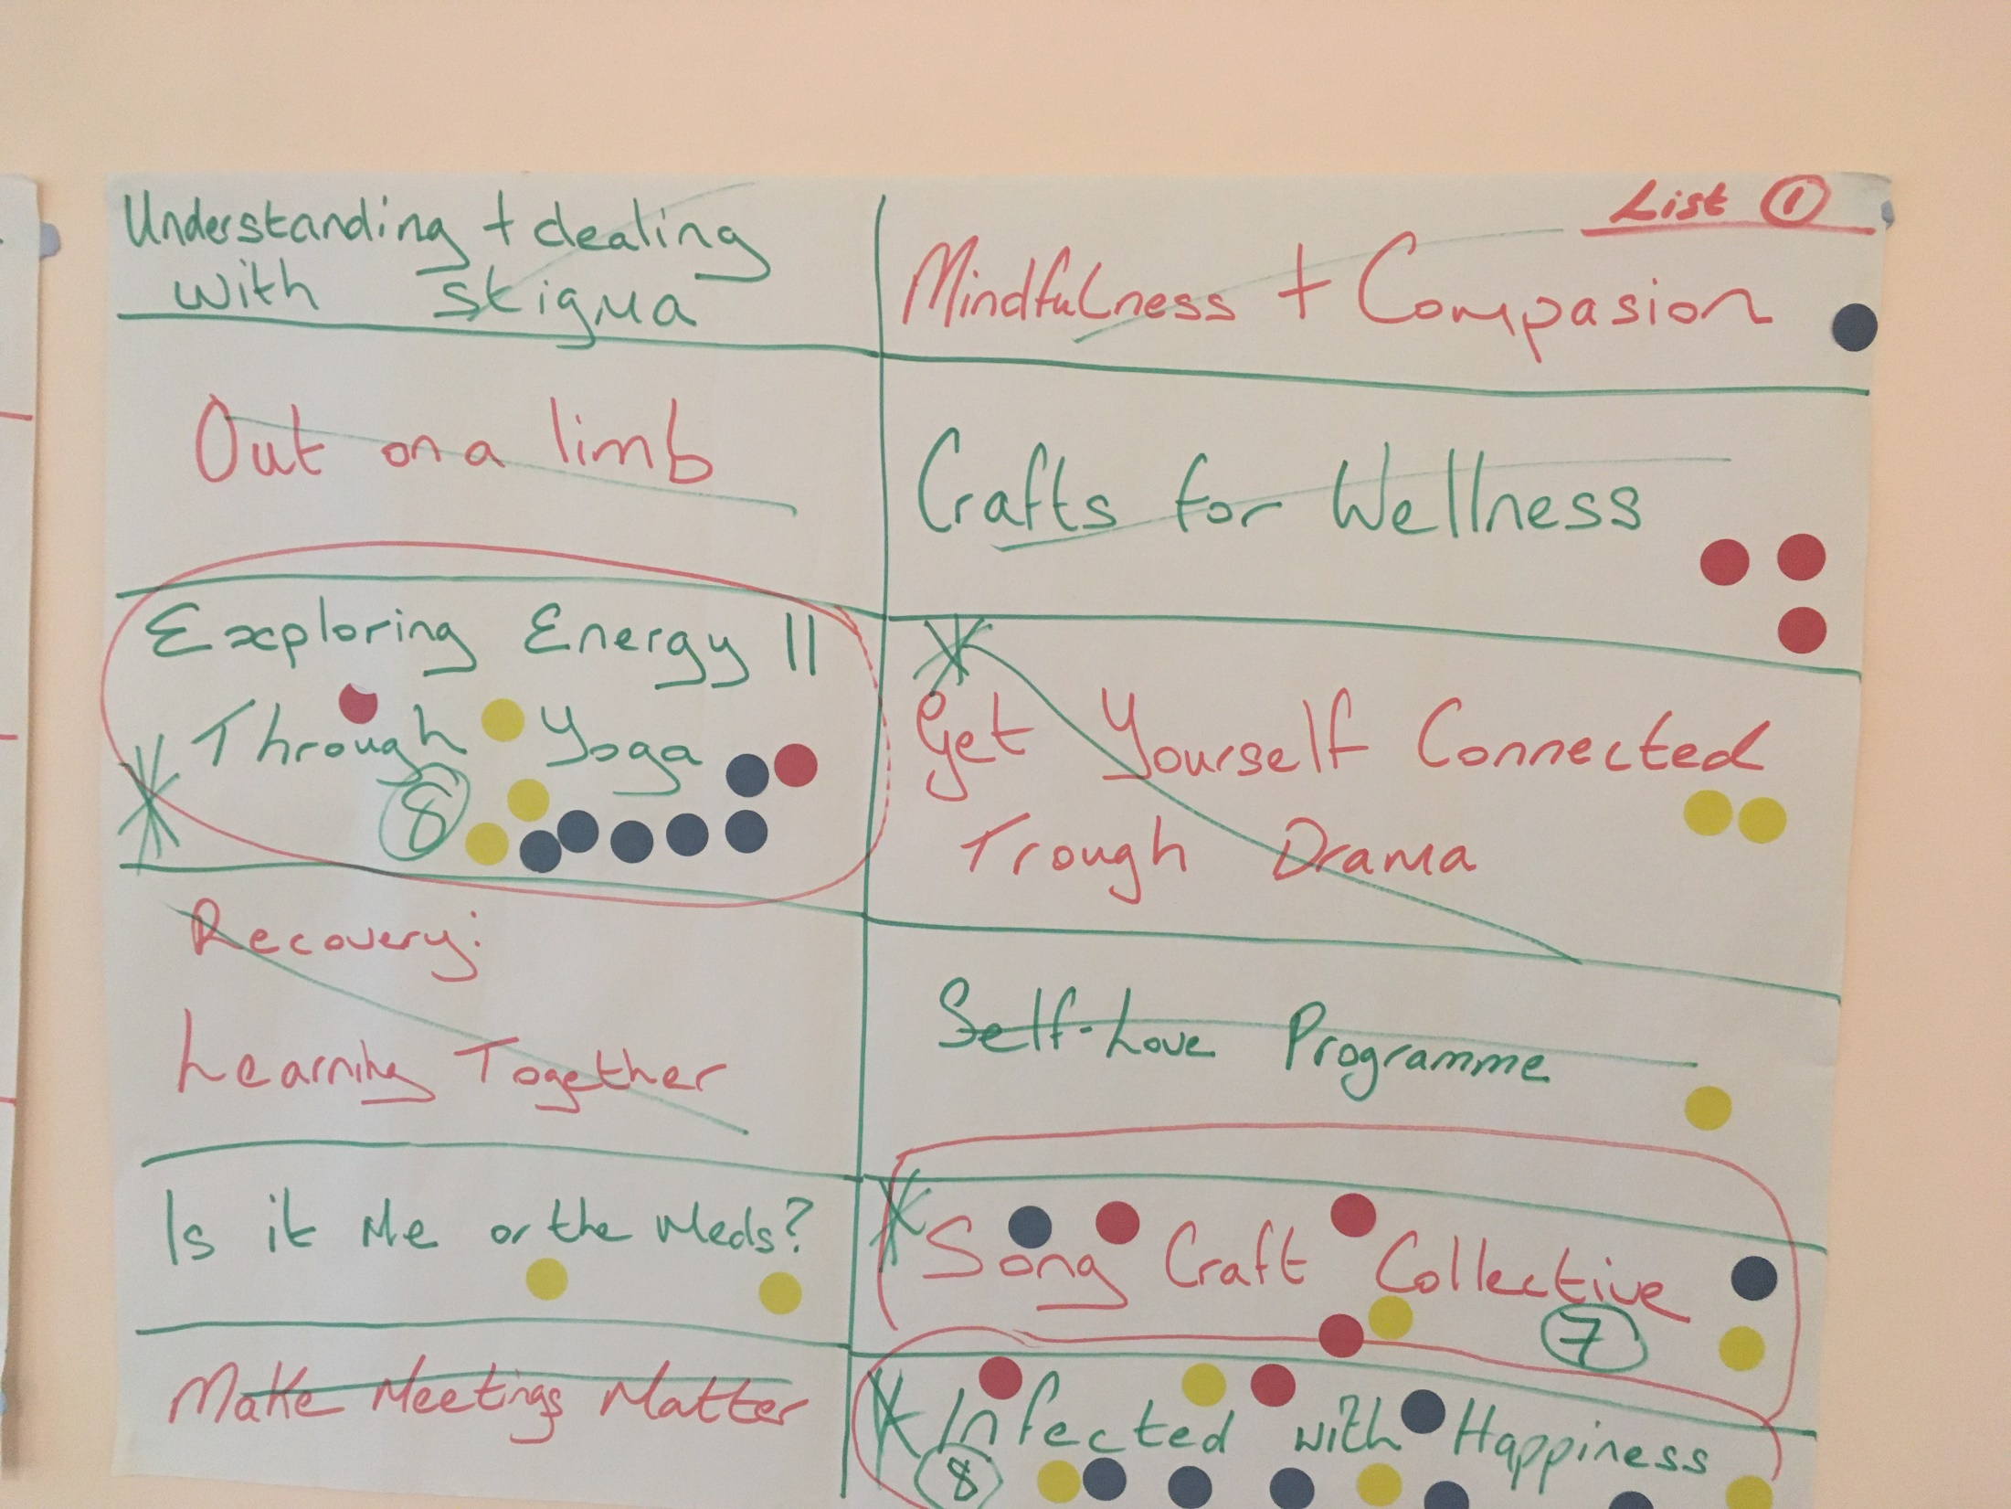

Slide 18
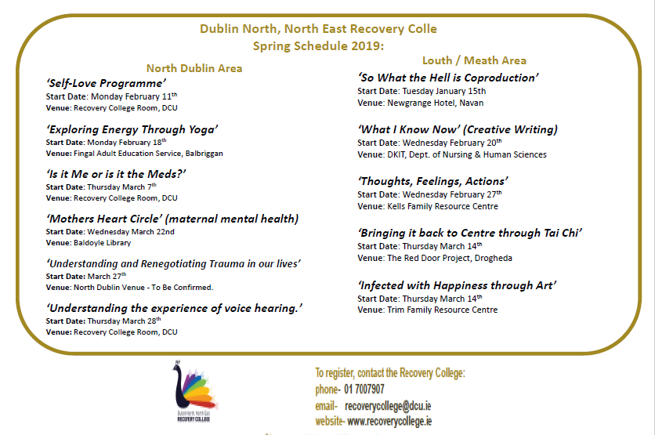

Slide 19
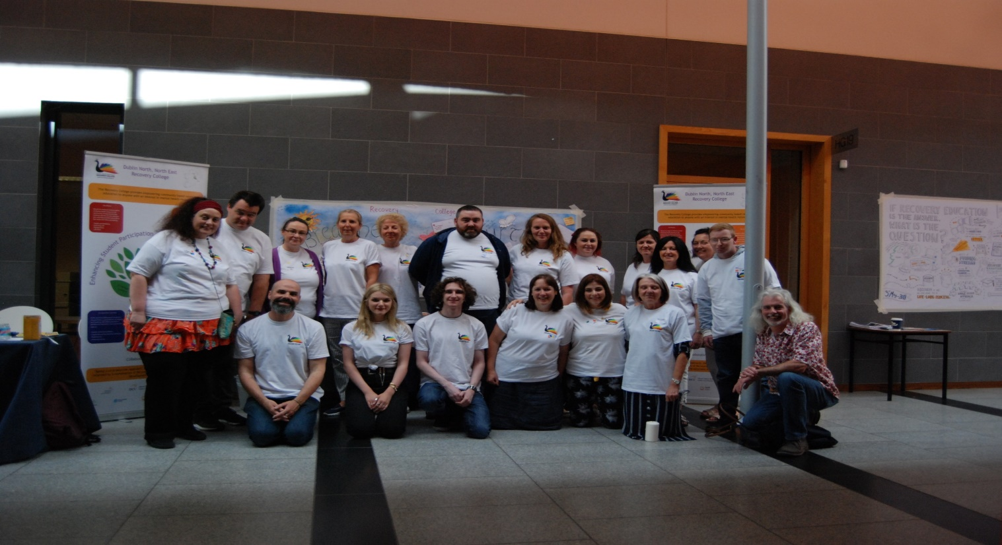
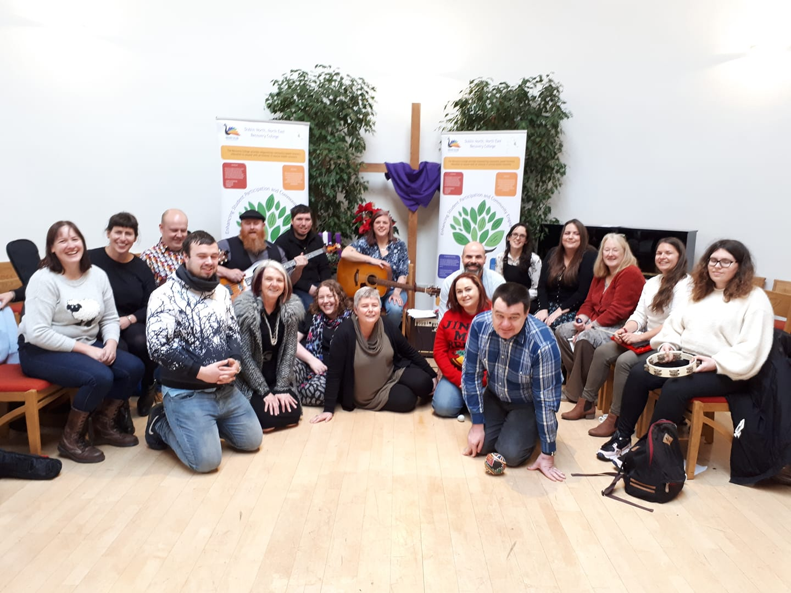
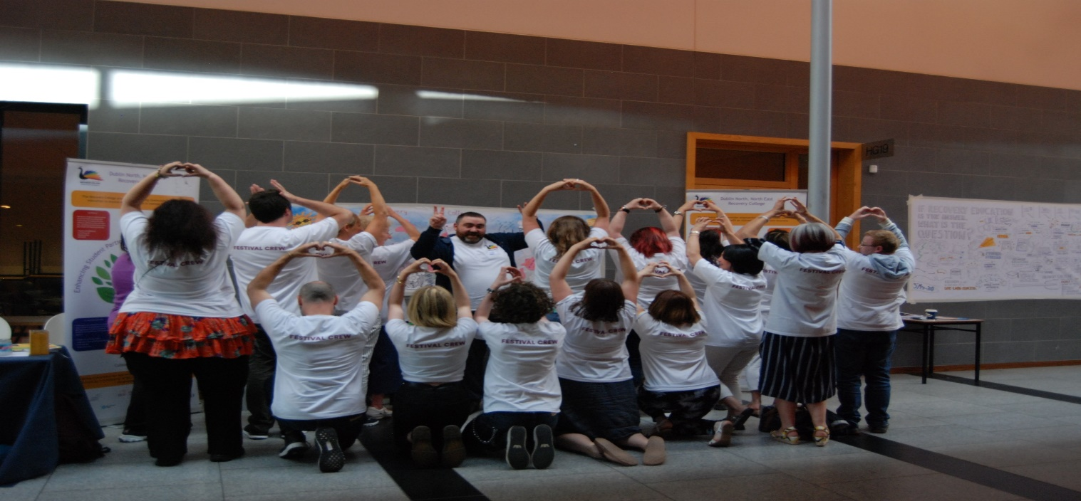
Shedding of labels and taking on new creative identities

Slide 20

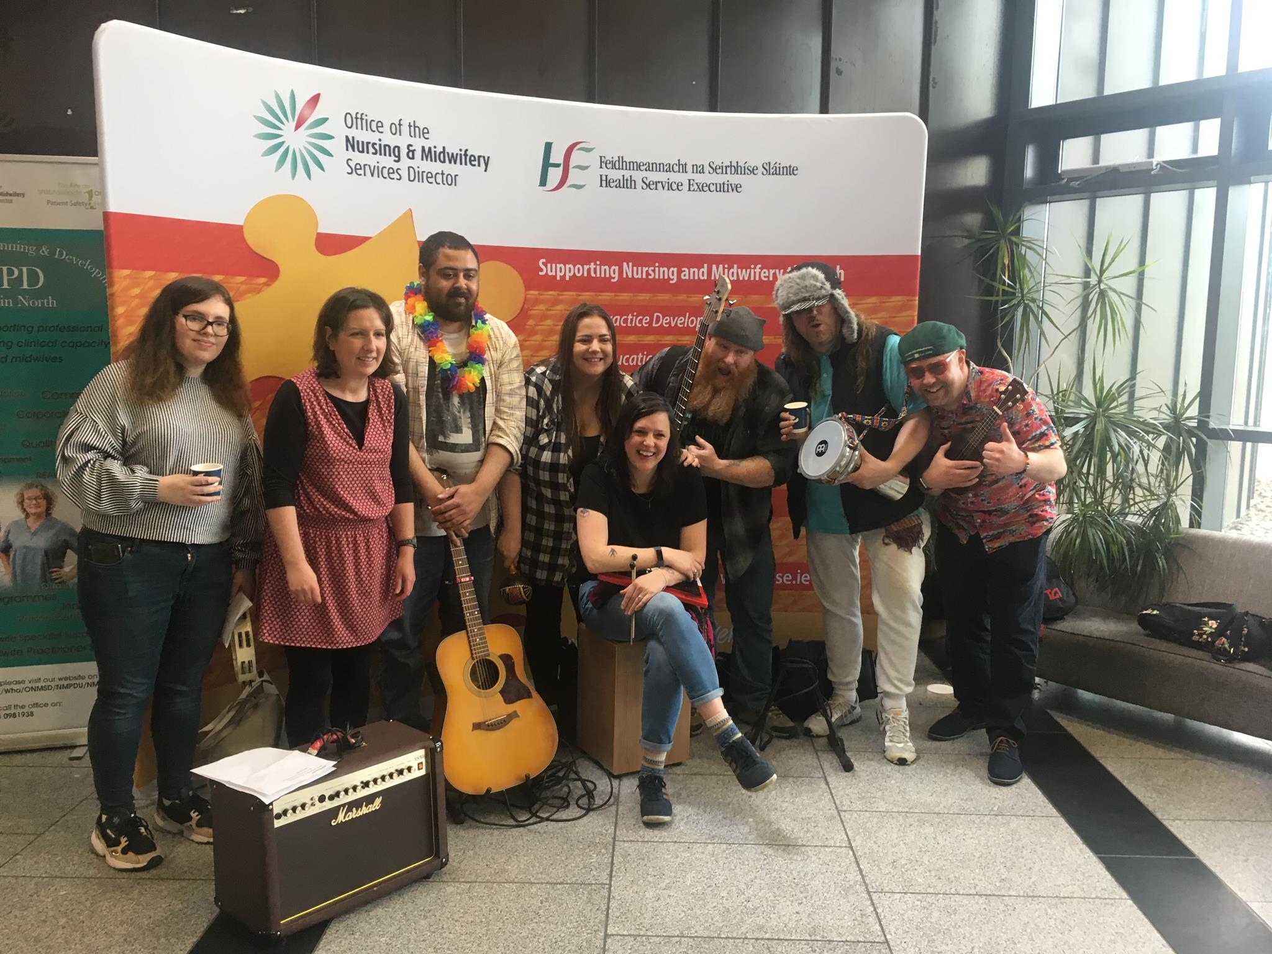

Slide 21


Slide 22
Proof of Concept….. Two Year Evaluation of Recovery College Impact on Personal & Social Recovery

Slide 23
Evaluation included……
1146 Individuals participated in Adult Ed & Community Development programming during years one & two.

Slide 24
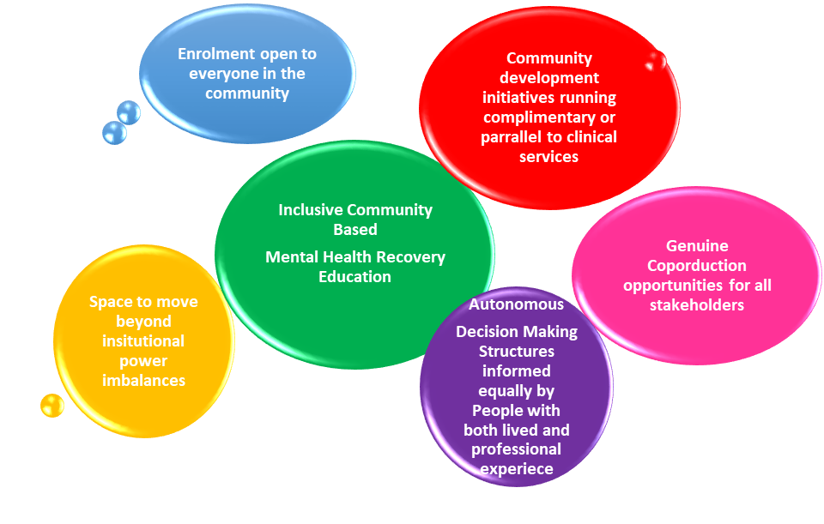
Our Emancipatory Approach Provides

Slide 25
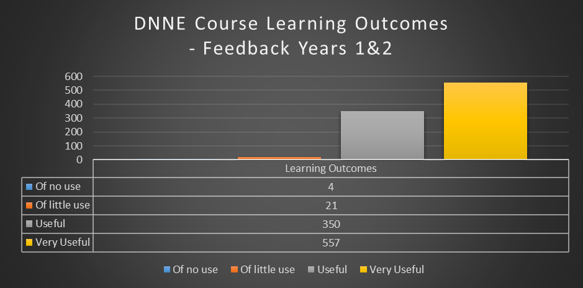
Course Learning Outcomes – Mean average across years 1 & 2

Slide 26
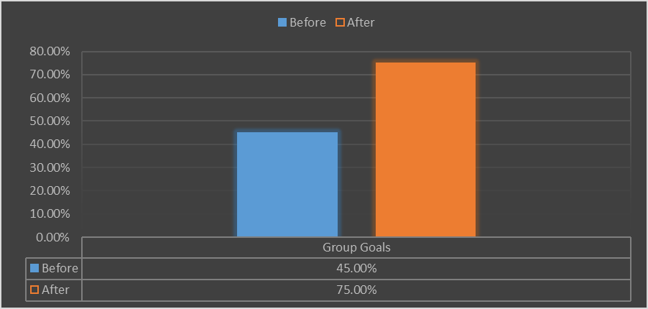
Group Learning Goals – Average student progress across during years 1 & 2

Slide 27
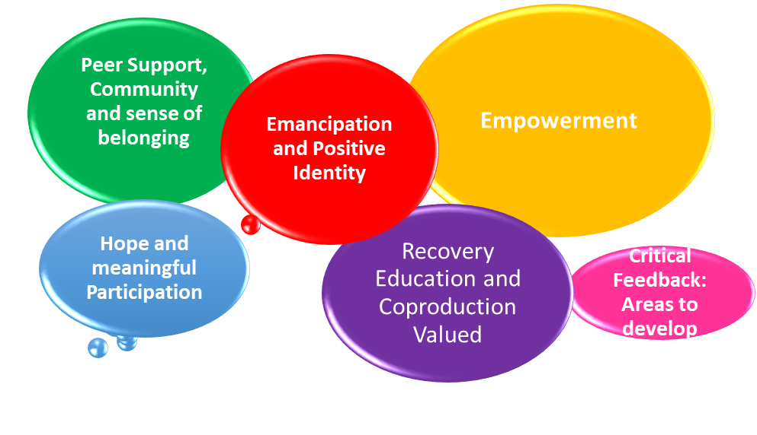
Emerging Focus Group Themes from Years 1 & 2

Slide 28
CHIME INDICATORS (Slade et al. 2012)
Students gauged their overall college experience, in terms of how their engagement with the Recovery College enhanced their sense of:
Connection with others.
Hope
Identity (reclaimed)
Meaningful Participation
Empowerment
(1 = Not at all, 2 = A little, 3 = Don’t know, 4 = A lot, 5 = Quite a bit)

Slide 29
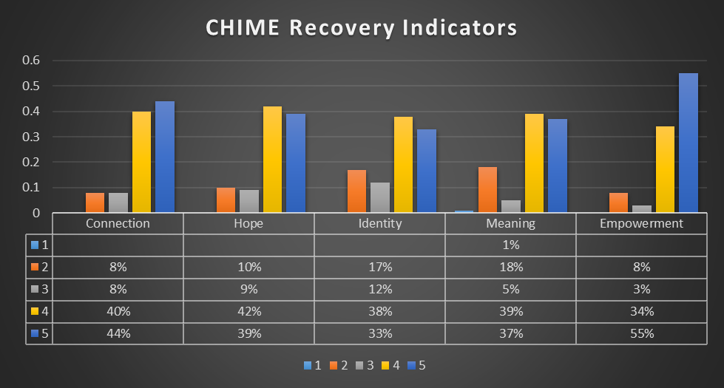
CHIME INDICATORS (Slade et al. 2012)
Over 80% of respondents rated their recovery college experience between 4 and 5 out of 5, in terms of:
Enhancing their own sense of empowerment
Developing meaningful connections with others.
Becoming more hopeful for the future.
Over 75% of participants rated their recovery college experiences between either 4 or 5 out of 5, in terms of:
Connecting with other people
Enhancing their own sense of identity

Slide 30
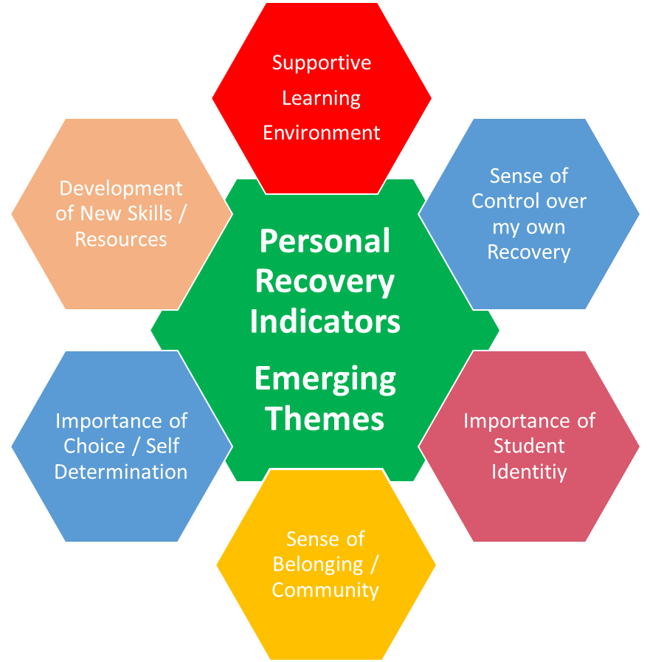
Personal Recovery

Slide 31
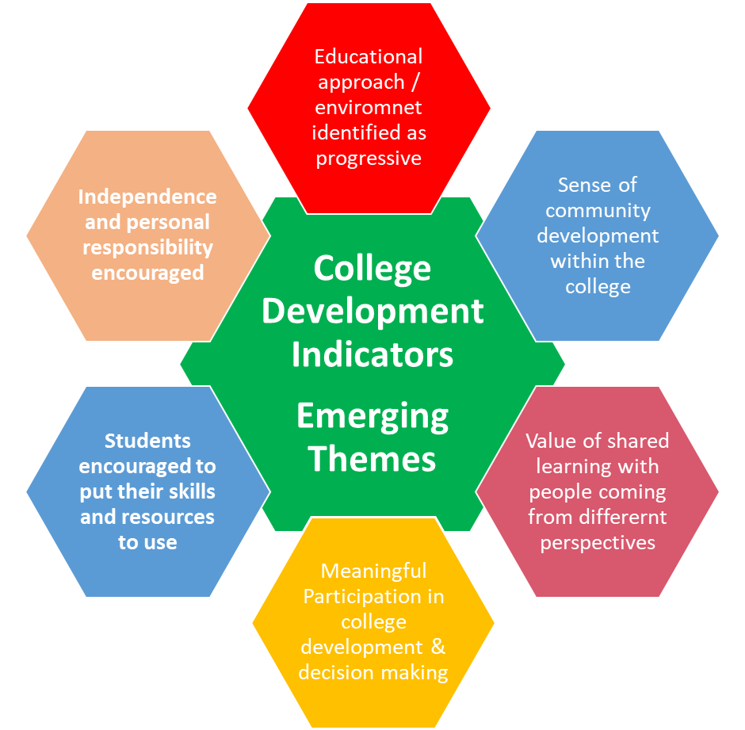
College Development Indicators

Slide 32

www.recoverycollege.ie.

