Slide 1
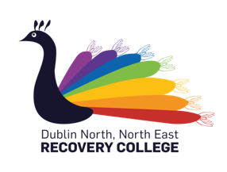
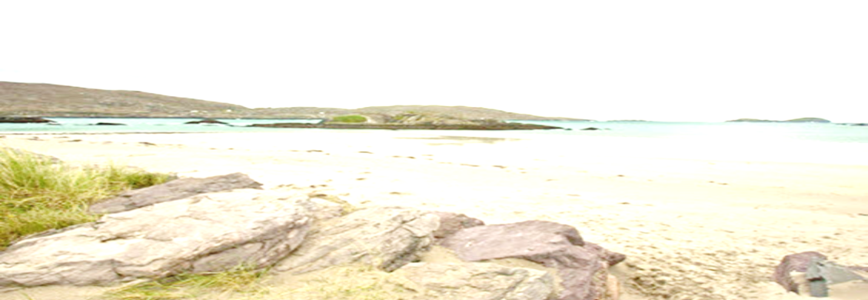

THE DUBLIN NORTH, NORTH EAST RECOVERY COLLEGE
Dublin North, North East Recovery College
In collaboration with the DCU School of Nursing & Human Sciences
Online Summer Schedule
Courses commence the week of Monday May 18th
Song creation collective!
This musical adventure explores the different components involved in song writing and the transformative effect that music can have on a persons mental health, supporting participants towards working collaboratively in the development and performance of a piece of music.
‘Self Love Programme,’
‘My Home, My Sanctuary,’
Healthy Relationships with Food,’
Thoughts, Feelings & Actions’
Meeting online, Making it Meaningful
‘Understanding Stigma and Dealing with Discrimination’
Understanding Trauma and how it Impacts us.’
.
Full Programme Details & Arrangements Available To Follow
To register, contact the Recovery College:
phone- 01 7007907
email- recoverycollege@dcu.ie
website- www.recoverycollege.ie

